Slide 1
How to install Kali Linux?
I normally run Linux distributions from Oracle's Virtual Box because most of my computers are primarily Windows 10-11. There are 2 ways to install the Kali Linux: (1) That said there are a couple of good reasons to do bare metal installations: -Better GPU performance -More hands-on socket control -More hands-on control of ethernet and wireless devices -less leaky network footprint by default (The Windows host won't try to reach out, update or attempt any noisy telemetry nonsense)
(2) The reasons to do virtual machines (We will focus on it): -Deploy them on remote hosts (portability) -Isolate your host system from activities in your VM (better for testing) -Quickly reset the VM to its default -Run multiple operating systems at once

Slide 2
How to install Kali Linux?
The first step to installing Kali Linux is downloading and setting up a virtual machine on your Windows PC. Oracle VM Virtual Box is recommended as it is free to use and simple to set up. Next is to Download the Windows hosts binary setup from the VirtualBox website. Once the download is complete, launch the VirtualBox installation setup and confirm administrator access if asked. Go through the installation wizard and then press finish to complete the process. Then download the Kali Linux VM image. The VM image will allow you to run the Kali Linux operating system on your current Windows PC through the virtual box we just installed. Confirm whether your PC is 32-bit architecture or 64-bit, and then select the one needed for your device. When downloading I used the 32bit just to not overload my OS and keep some of my free space. Extract the contents of the downloaded file. VirtualBox and Kali Linux VM image is ready, we can import it into our VM. Search for the Oracle VM Virtual box in the Start menu and launch the Best match. Select the .vbox file and click on Open Once the VM is loaded, you will see it appear in VirtualBox. Click on the green Start icon to fire up Kali Linux. Log in using the default kali user profile using the password kali. Let’s see step by step process.

Slide 3
Virtual Box Kali Linux Installation Process
Step 1) Download and install Virtual Box (It is free to use):
https://www.virtualbox.org/wiki/Downloadshttps://www.virtualbox.org/wiki/Downloads
Step 2) Download Kali virtual box machine (make sure you download the virtual box machine):
https://www.kali.org/get-kali/#kali-virtual-machineshttps://www.kali.org/get-kali/#kali-virtual-machines
Step 3) Extract Kali Virtual box machine to an empty folder, preferably on an SSD
Step 4) Double click kali-linux-2022.3-virtualbox-amd64.vbox
Step 5) In the virtual box left window select the kali Linux machine
Step 6) In the virtual box tool bar click the start button
Please see these steps in details

Slide 4
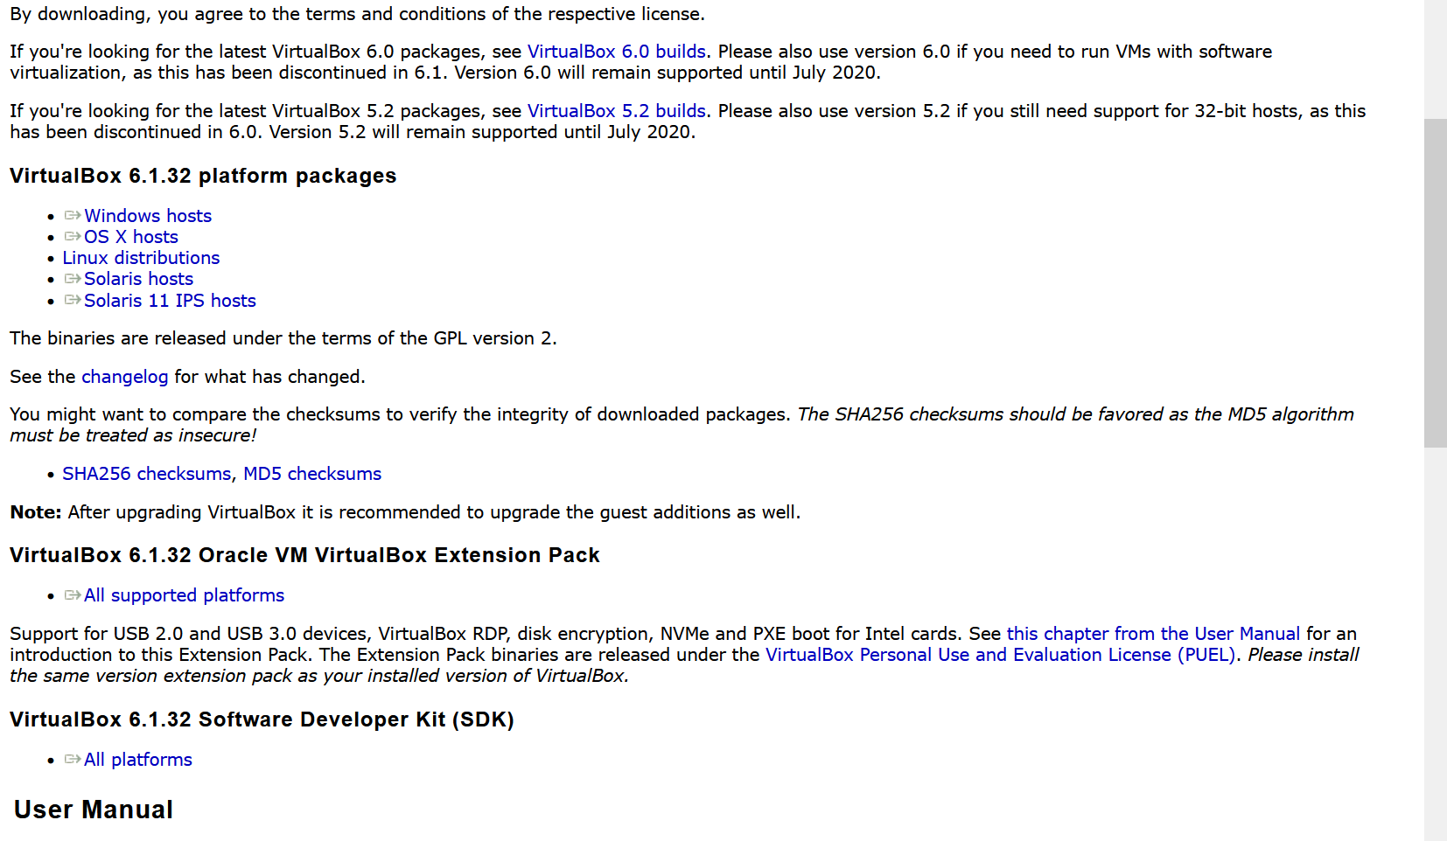
Step 1) https://www.virtualbox.org/wiki/Downloads
Install and open
Install

Slide 5
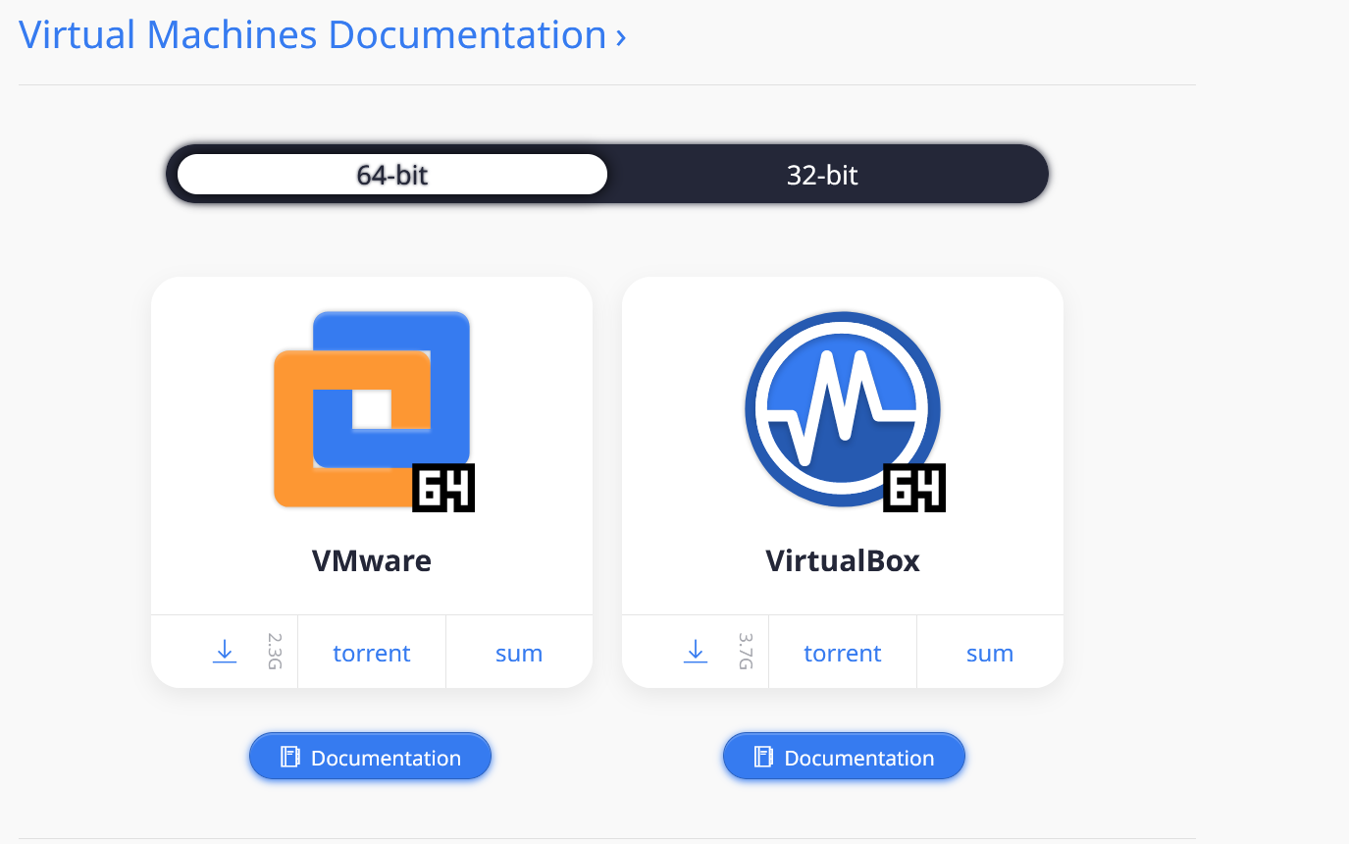
Step 2) https://www.kali.org/get-kali/#kali-virtual-machines
Install

Slide 6

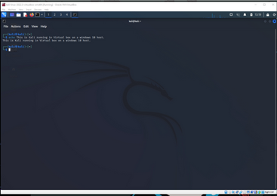
Other steps) Open Oracle Virtual Box. Click file at the top left corner, click import appliance
Click the folder button next to file.
Choose
Click open
At the bottom of the page click Next
Change RAM’s, and CPU. Change the folder you want to keep the program in
Click Next and agree
Should take about 3 – 2 minutes to download
Double click on this
Default login:
Kali Linux Windows
Username: kali
Password: kali
Congratulation for Kali Linux Installation

Slide 7
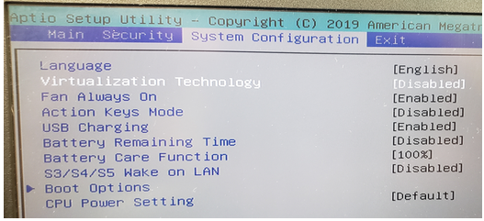
Common Problem for Kali Linux Installation
1. If you get a memory error when starting the virtual machine, make sure virtualization is turned on in your BIOS:
2. Sometime, you will need a zip tool such as 7-zip to unzip the Kali Linux file: https://www.7-zip.org/

